Slide 1

Comparative Analysis of NYC Airbnb Rentals
5000 Data Analytics Final Project Presentation
By: Daniel Mehta & Thomas Nash

Slide 2
Problem Statement
A comparative analysis of value and performance between two Airbnb rental types across the five boroughs of New York City.
Executive Summary
This analysis examined Airbnb rental data across New York City's five boroughs, focusing on pricing patterns and predictive modeling. The study utilized a dataset of 102,599 listings, which was cleaned and processed to 85,029 valid entries for analysis.

Slide 3
Data Preprocessing & Cleaning
The initial dataset underwent several cleaning steps:
Removal of irrelevant columns including ID fields, geographical coordinates, and text-based descriptions
Standardization of price and fee columns by removing currency symbols and converting to float values
Treatment of missing values in critical columns
Encoding of categorical variables using one-hot encoding
Creation of derived features including total cost and price per night

Slide 4
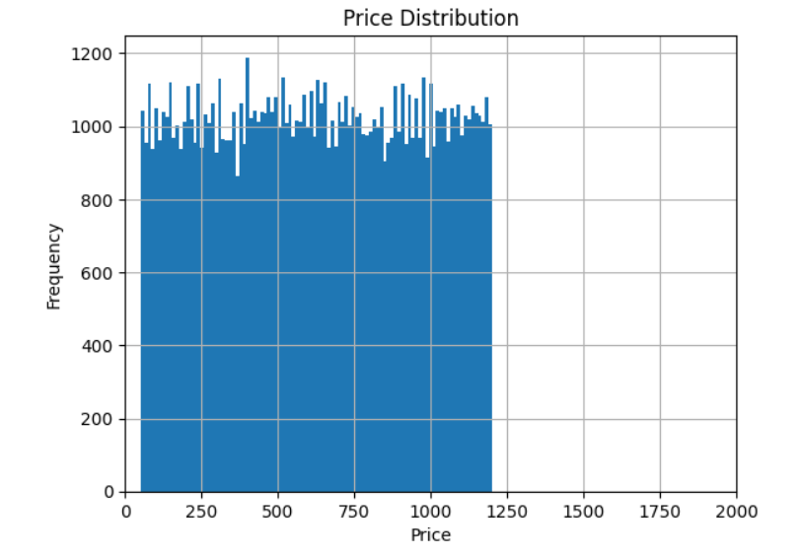
Key Findings: Distribution Patterns
The total cost distribution shows a right-skewed pattern, with most listings clustered in the lower price ranges
Manhattan emerged as the borough with the highest average costs
Entire homes/apartments consistently commanded higher prices across all boroughs
4
4

Slide 5
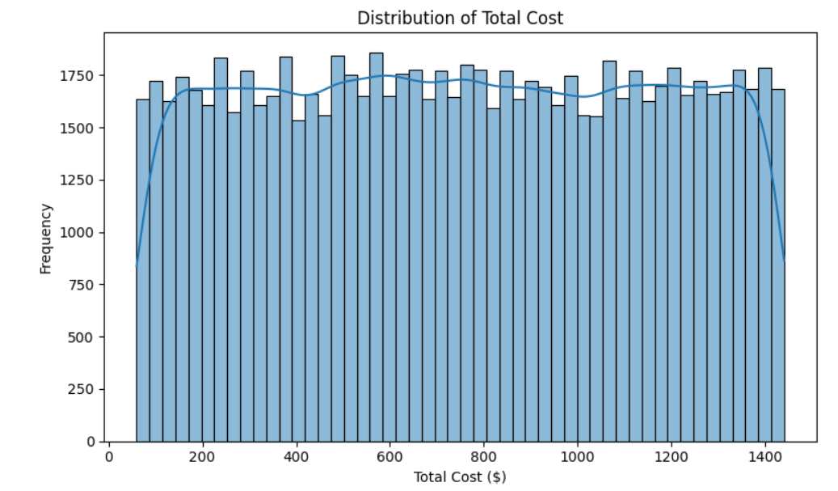
Key Findings: Distribution Patterns
The total cost distribution shows a right-skewed pattern, with most listings clustered in the lower price ranges
Manhattan emerged as the borough with the highest average costs
Entire homes/apartments consistently commanded higher prices across all boroughs
5
5

Slide 6
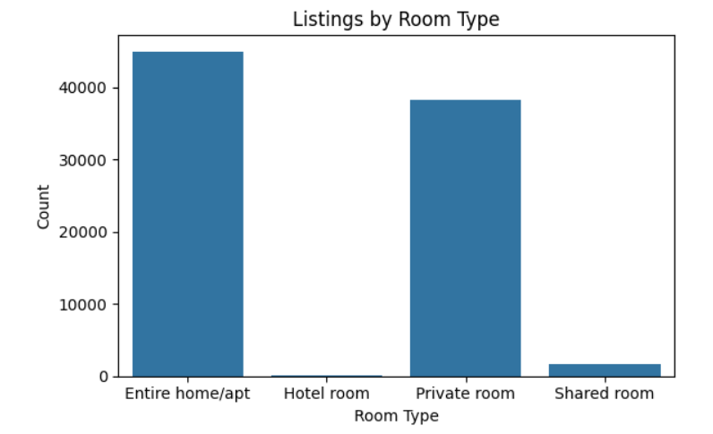
Key Findings: Room Type Analysis
Entire homes/apartments represent the majority of listings
Private rooms form the second largest category
Hotel rooms and shared rooms make up a smaller portion of the market
6
6

Slide 7
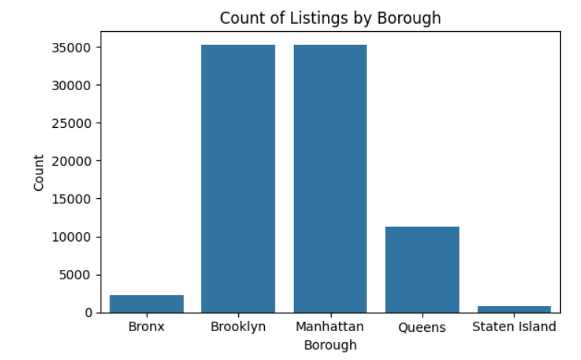
Key Findings: Geographic Distribution
Manhattan and Brooklyn dominate the market in terms of listing volume
Staten Island has significantly fewer listings compared to other boroughs
Each borough shows distinct pricing patterns based on room types
7
7

Slide 8
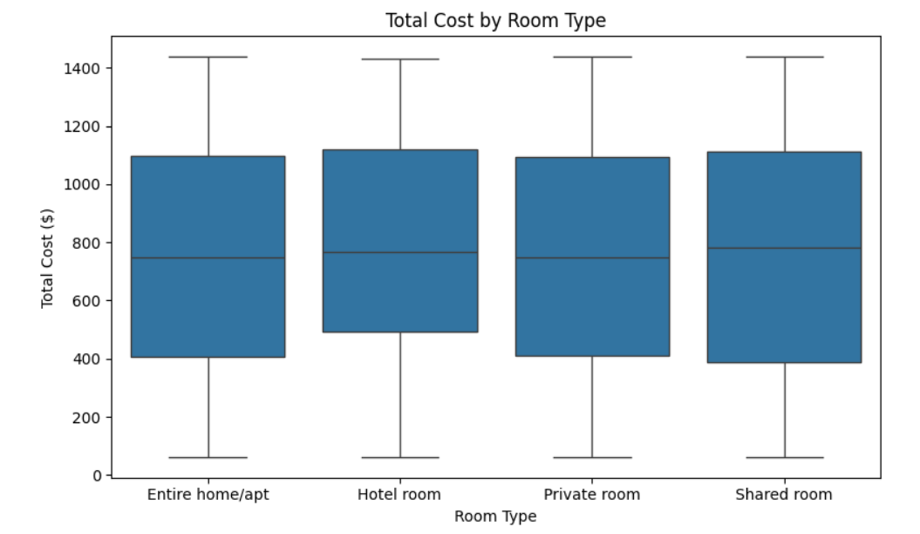
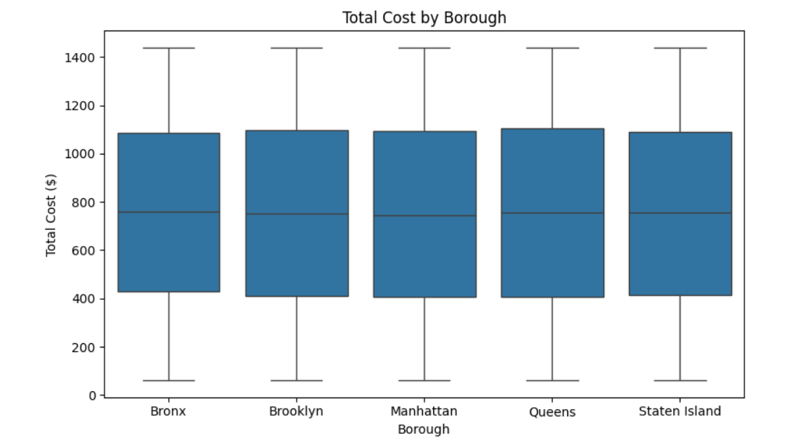
8
8

Slide 9
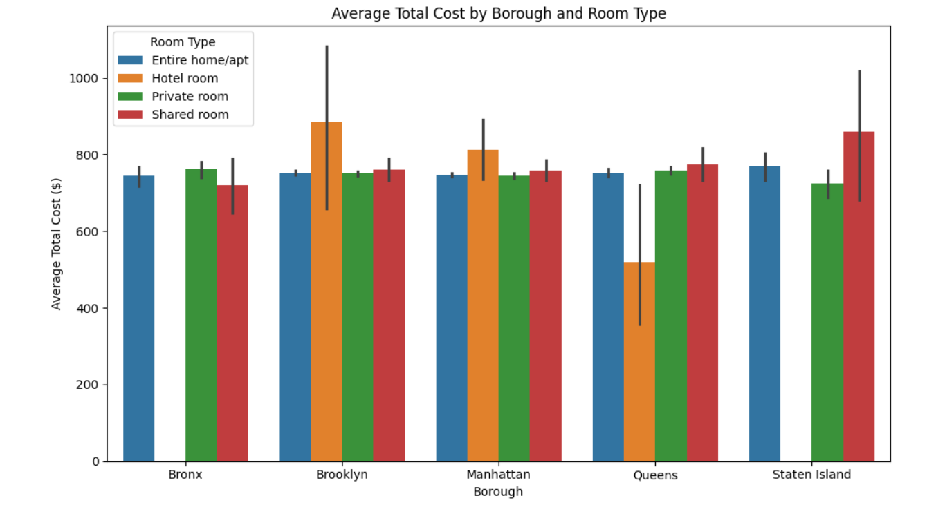
9
9

Slide 10
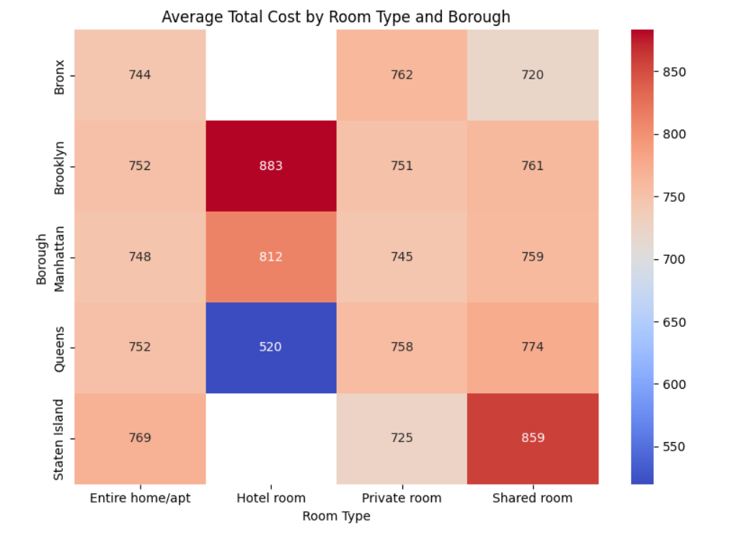
10
10

Slide 11
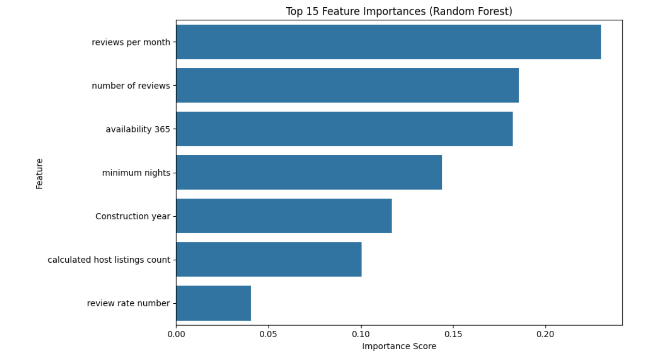
Key Findings: Price Variations
Significant price variations exist between boroughs
Room type is a major determinant of price
The combination of borough and room type creates distinct price tiers
11
11

Slide 12
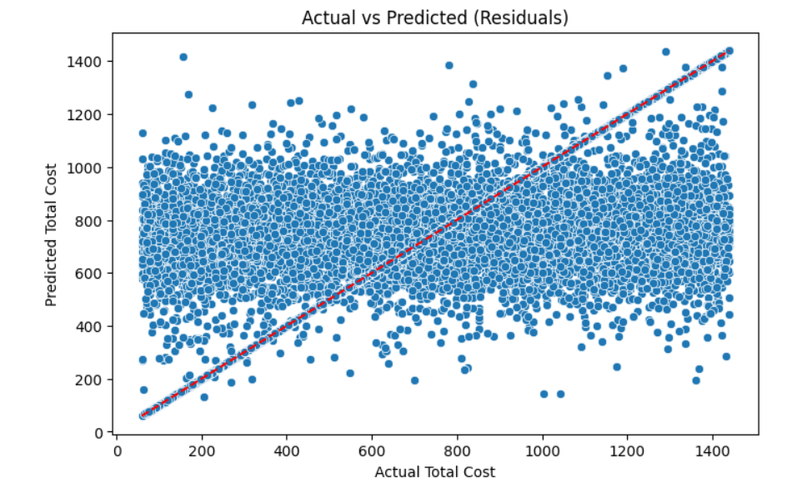
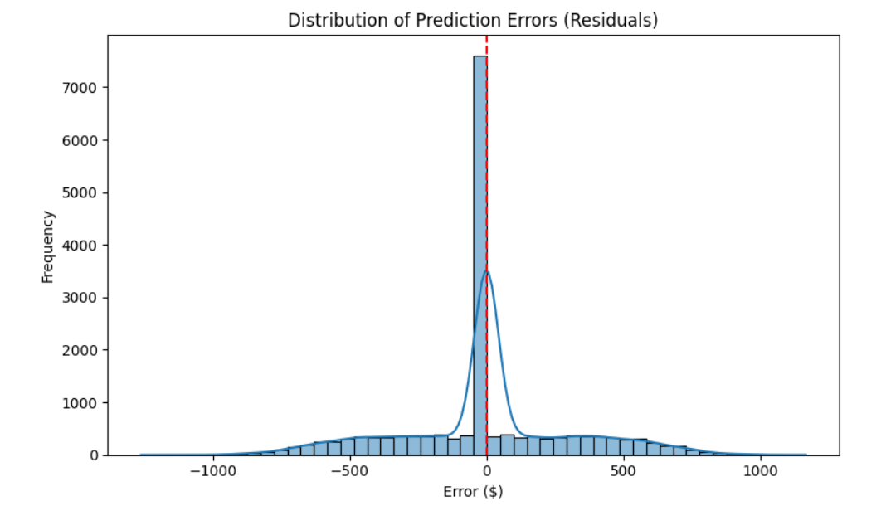
12
12

Slide 13
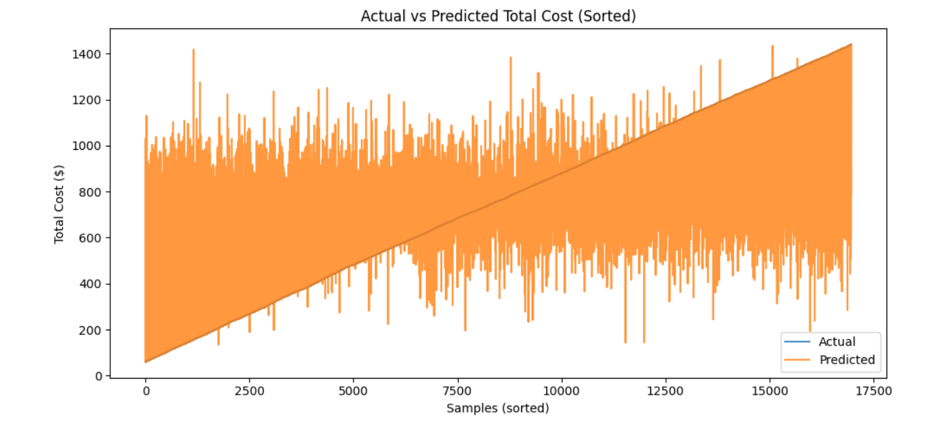
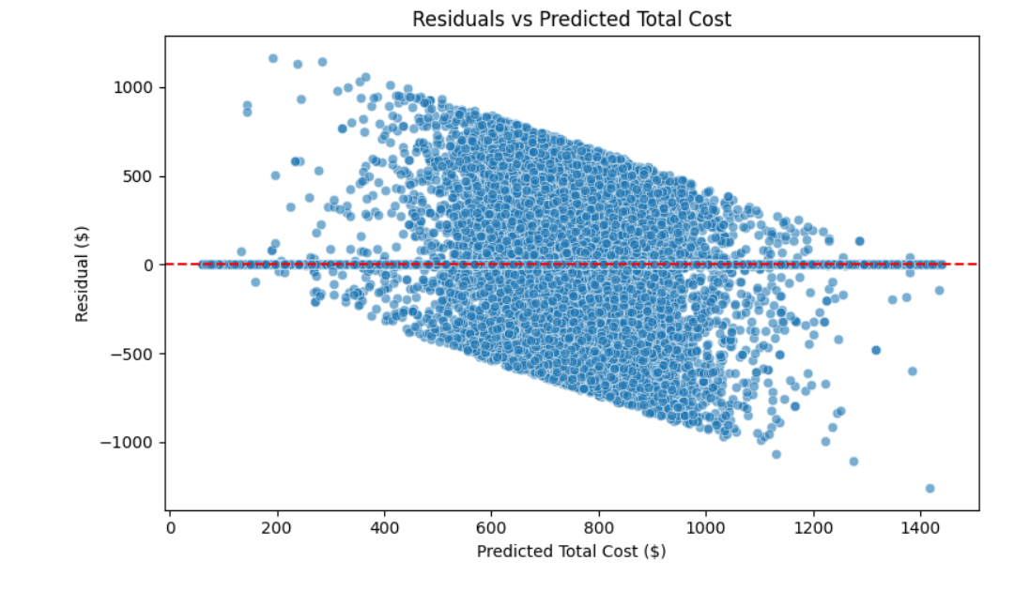
13
13

Slide 14
Overall Results
We compared multiple models including Linear Regression, XGBoost, Random Forest, and ExtraTrees. ExtraTrees performed the best.
Strengths
Model performs well overall – it captures general patterns in total cost across listings
Prediction errors are centered around 0 with no major bias in over or under-prediction
Most predictions are accurate within $200
Weaknesses
Model struggles with very expensive listings – tends to underpredict the high end
Guest activity features (reviews, availability) are more important than location
Some predictions are too "average" – doesn’t always capture extreme cases
Predictive Modeling Results
Using an ExtraTrees Regressor model:
Mean Absolute Error: $200.22
Root Mean Square Error: $311.63
R² Score: 0.3839
Model Performance Analysis
Strengths:
Balanced predictions around the true values
Reasonable accuracy for typical price ranges
No systematic bias in predictions
Limitations:
Lower accuracy for high-priced listings
Moderate R² score indicating room for improvement
Some difficulty capturing extreme price cases

Slide 15
Feature Importance
The model identified several key pricing factors:
Construction year
Minimum nights requirement
Review-related metrics
Borough location
Room type
Recommendations
Price optimization strategies should consider both borough and room type
Different pricing models may be needed for luxury/high-end properties
Focus on accurate pricing in the most common price ranges
Consider seasonal variations in future analyses
Methodology Notes
The analysis employed various visualization techniques including histograms, box plots, heat maps, and scatter plots to understand the data distribution and relationships. The predictive modeling phase used the ExtraTrees algorithm with an 80/20 train-test split. We selected ExtraTrees due to its superior performance across all metrics during model comparison.

